Slide 1
Diagnosis of
Helicobacter pylori
Dr. Shereen H. Atef
Consultant Clinical Pathology
Alsalama Hospital

Slide 2


Slide 3
Clinical and Economic Impact of PUD H. pylori Infection.
More than 25 million Americans will develop peptic ulcer disease (PUD) at some point during their lifetime
700,000 Endoscopies every year
H. pylori is associated with >80% of duodenal ulcers
3.8 Million Prescriptions/ year
PUD costs approximately $6 billion annually in the US

Slide 4
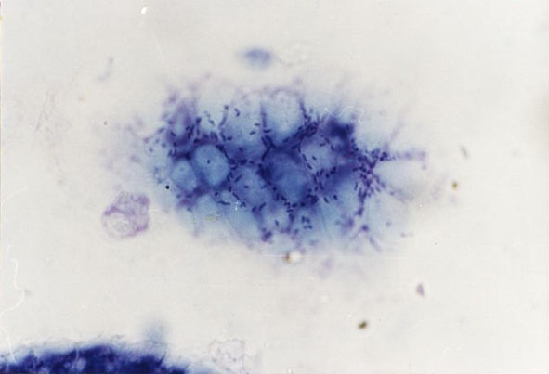
Helicobacter pylori
A spiral shaped, Gram-negative, microaerophilic, and flagellated bacterium, living in the stomach and duodenum
About 3 microns long with a diameter of about 0.5 micron
Causing up to 80% of peptic ulcers, more than 90% of duodenal ulcers, and some types of gastritis
Helicobacter pylori (blue bars, curved, 2-4 microns) localized in the mucus on the mucosa surface, at the intercellular lines. Photo: tangential section of the gastric mucosa

Slide 5
Symptoms
Most of the time, infected individuals are asymptomatic
15-20% of infected individuals will develop severe gastrointestinal disease
  Gastric tumors (particularly stomach body)
  Peptic ulcers & active gastritis
Less common symptoms include nausea, vomiting, and loss of appetite.
Bleeding can also occur.
Recent studies have shown an association between long-term infection and the development of gastric cancer.

Slide 6

Worldwide Prevalence of Infection
Approximately two-thirds of the world's population is infected with
H. pylori.
  70% - 90% in developing countries
  25% - 50% in developed countries

Slide 7
Epidemiology
Over half the population is infected in early childhood.
Most of those infected never have symptoms.
The bacteria are most likely spread from person to person through fecal-oral or oro-oral routes.
Possible environmental reservoirs include contaminated water sources.
The source of H.pylori is not yet known.

Slide 8
H. pylori Infection Risk Factors
Low socioeconomic status
Crowded or unsanitary living conditions
Born in a developing country
Children in the family
Exposure to gastric contents
  Nurses
  Endoscopists
Graham DY et al. Gastroenterology. 1991;100:1495.

Slide 9
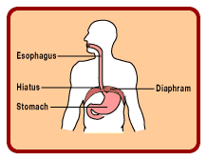
Transmission
It is thought that H. pylori is transmitted orally by ingestion of food or water contaminated with fecal matter.
It is possible that H. pylori could be transmitted from the stomach to the mouth through gastro-esophagal reflux, and could then be transmitted through oral contact.

Slide 10
H. pylori Infection
The bad news
High morbidity
  Chronic and acute gastritis
  Peptic ulcers
  Gastric cancer
Classified by WHO as a Class I carcinogen
Notes:
Good news bad news situation.
The bad news is:

Slide 11
H. pylori Infection
The best news is:
It is curable

Slide 12
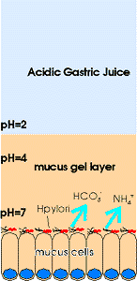
Pathogenicity
Stomach acid
H.pylori lives in the mucus lining to escape from the highly acidic gastric juice. (Its helical shape facilitates its penetration of the mucus layer.)
It can fight the acid by excreting an enzyme called urease.
Gastric epithelium

Slide 13

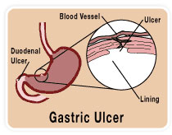
The immune system responds to the infection by sending white cells, killer T cells, and other infection fighting agents.
However, they cannot easily get through stomach lining to reach the infection.
As the immune response grows, immune cells die and release destructive compounds on the stomach lining cells.
Within a few days, gastritis and perhaps eventually a peptic ulcer results.

Slide 14
Diagnosis
Several diagnostic tests are used to detect Helicobacter pylori infection. These tests, including invasive and noninvasive techniques, both have high sensitivity and specificity. The advantages of the various techniques will be described

Slide 15
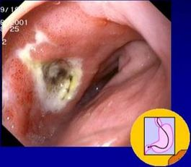
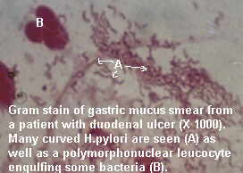
Invasive Techniques:
1.Endoscopy
An endoscopy is invasive diagnostic test for H. pylori where a biopsy is taken and tested for the bacterium using a gram stain.

Slide 16
1.Endoscopy cont.
The endoscopical visualization of H. pylori colonizing the gastric mucosa using confocal endomicroscopy is one of the most impressive advances in the use of endoscopic techniques.
Studies describing gastric mucosal surface pattern with high magnification reported a good correlation with the histopathological findings for H. pylori infection and gastric atrophy.
However, the current position for endoscopy remains for the investigation of complications due to H. pylori and sampling biopsies for histology, rapid urease test, and culture.
Condensed Matter Theory & Biophysics Lab

Slide 17
Invasive Techniques:
2.Culture
Because of fastidious nature of H. pylori, culturing the bacterium is often tedious and is no more sensitive or specific than simple histologic analyses. Culturing H. pylori also involves the cost of endoscopy, making the method even less practical.
The specificity of H. pylori in culture is 100% and sensitivity is greater than 90%,but the use of the correct media and transport system is critical.
The clinical indication for performing H. pylori culture is to test for bacterial resistance to different antibiotics. H. pylori culture is the essential method in the individual management and the surveillance of resistance

Slide 18
Invasive Techniques:
3.Histopathology
Histologic analysis of biopsy. Routine histologic analysis of biopsy samples is common and practical. This technique is helpful, because one can visualize the mucosa, permitting detection of histologic gastritis

Slide 19
3.Histopathology
In spite of considerable interobserver variation, histopathology is still considered the gold standard in the diagnosis of H. pylori gastritis, as it includes the criteria for determination of acute/chronic inflammation, presence of glandular atrophy, intestinal metaplasia, density of H. pylori colonization and preneoplastic changes.

Slide 20
3.Histopathology
It is critically important for the pathologist to get the information from which exact localization the biopsies have been taken, especially for the assessment of gastric atrophy. Biopsies need to be taken from the mid antrum and from the greater curvature of mid corpus to provide best reliability for histopathology

Slide 21
Camplyobacter-like organism (CLO) test
This test is based on the fact that mucosal biopsy specimens can be inoculated into a medium containing urea and phenol red, a dye that turns pink in a pH of 6.0 or greater.
The pH will rise above 6.0 when H. pylori, the Campylobacter-like organism, metabolizes urea to ammonia by way of its urease activity
Only one-half hour is required for diagnosis of infection, and the test has shown 98% sensitivity and 100% specificity. These qualities have made the CLO test the invasive technique of choice for diagnosing H. pylori infection.

Slide 22
Invasive Techniques:
4.Molecular Diagnosis
Methods for the molecular diagnosis of H. pylori are applicable in various biological materials, that can be obtained by non or minimal invasive procedures, such as gastric brushes, 'string tests' and stool samples.

Slide 23
Noninvasive Techniques
Antibody detection
Antigen detection
Urea breath test employing urea-C14 or C13

Slide 24
1.Helicobacter pylori Antibody
Detection of IgG antibody..
serologic testing for antibodies to H. pylori using the enzyme-linked immunosorbent assay (ELISA) has become a widely accepted diagnostic test.
The test is simple, inexpensive, and readily available. ELISA detects IgG with a sensitivity of up to 99% and is 100% specific. BUT
A positive result does not differentiate past or present infection with Helicobacter pylori.
This test is less sensitive than biopsy detection (histology, urease test).
Antibodies are slow to develop after infection (5-10 weeks) and may remain positive for >12 months after eradication of H. pylori.

Slide 25
1.Helicobacter pylori Antibody
Serology should be considered in case of peptic bleeding ulcers, MALT lymphoma, gastric atrophy or ongoing PPI therapy.
False-positive results are mostly due to prolonged antibody persistence after successful eradication therapy

Slide 26
2.Helicobacter pylori Antigen
This method detects H pylori antigen in stool specimens and can be used for diagnosis . A positive result is indicative of H pylori presence (96% sensitivity); however some individuals may have H pylori antigen but no disease.
A negative result indicates absence of H pylori or an antigenic level below the assay limit of detection (96% specificity).
False negative results may be obtained on specimens from patients who have ingested selected compounds (antimicrobials, proton pump inhibitors, bismuth preparations) within the 2 weeks prior to specimen collection.

Slide 27
False stool antigen test Results
Why false positives?
Antigens eliminated in feces for a long period after eradication
  Gastric mucosal replacement takes less than 1 week
H. pylori can survive in gastric environment
  Biologically active spiral form
  Dormant coccoid form- does not produce urease
    Biopsy based test showed neither
Cross-reaction with other organisms?
Long-term retention of H. pylori antigen in colon (appendix, diverticula)
Why false negatives?
Decreased bacterial density = low stool antigen optical densities
High genetic variability of bacterium leading to high variability of antigenic epitopes

Slide 28
3.Breath test
Although H. pylori itself can not be detected noninvasively, its urease activity can be detected by way of a breath test.
The urease enzyme is not present in mammalian cells, so the presence of urease in the stomach is evidence that bacteria are present.
The presence of urease in not specific but other bacteria are not usually found in stomach

Slide 29
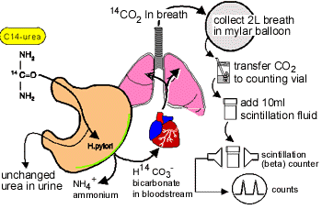
Principle of Breath Test
To detect H.pylori; urea labeled with C14 is swallowed by the patient. If gastric urease from H.pylori is present, urea is split to form CO2 and NH4 at the interface between the gastric epithelium and lumen and CO2 14 is absorbed into blood and exhaled in the breath

Slide 30
In the C14-urea breath test patient fast for about 6 hours (from midnight). The test is usually performed in the morning.
Patient swallows a capsule or drink water which contains one microCurie of C14-urea. Then after 10 min (the exact details may vary from place to place) provides the breath sample usually by blowing up a small balloon or card.

Slide 31
The C14-urea contains a tiny amount of radioactive material which passes out of your body in a day or so in the urine and breath.
The amount of radioactive exposure from the test is less than you will normally receive in one day from nature. The test is quick and simple to perform, and much less expensive than endoscopy.

Slide 32
Notes
The breath test technique reflects only current infection with H. pylori.
The test detects actual H. pylori organism by the presence of their urease and not the immune reaction as in serological tests
Compared to 13C-UBT and the SATs, serology is inferior for the diagnosis of active infection and not useful for controlling therapeutic success

Slide 33
Diagnostic Test Comparison
Testing Characteristics | Serology | UBT | SAT | Biopsy
Sensitivity / Specificity§ | 85% / 79% | 95% / 96% | 96% / 97% | 95% / 99%
Detects previous infection | Yes | No | No | No
Tests for eradication | No | Yes | Yes | Yes
Low cost | $$ | $$$ | $$$ | $$$$
Sensitivity / Specificity | 85% / 79% | 96% / 97% | 96% / 97% | 95% / 99%
Detects previous infection | Yes | No | No | No
Tests for eradication | No | Yes | Yes | Yes
Low cost | $$ | $$$ | $$ | $$$$
Need to account for false negative with PPIs
UPT = Urea breath test SAT = Stool antigen test
Notes:
Numerous commercially available tests measure IgG antibodies to H. pylori
Simple, relatively inexpensive
Accuracy varies widely (by test, location) Sensitivity: 85% Specificity: 79%
False positive tests, after therapy (72% positive at 3-4 yrs) atrophic gastritis, intestinal metaplasia
Loy et al. AJG 1996;91:1138; Cutler et al. Am J Med 1998;105:18
Laine L et al. Ann Intern Med 1998;129:547-550
Background: Proton-pump inhibitor therapy may cause false-negative results on Helicobacter pylori diagnostic testing.
Objective: To determine the frequency and duration of conversion of urea breath test results from positive to negative in patients given a proton-pump inhibitor.
Setting: Two urban university gastroenterology clinics.
Patients: Patients infected with H. pylori who had positive results on urea breath tests.
Intervention: Lansoprazole, 30 mg/d for 28 days.
Measurements: The urea breath test was repeated at 28 days. If the results were negative, testing was repeated 3, 7, 14, and 28 days after completion of therapy until the results reverted to positive.
Results: 31 (33%) of 93 patients in whom H. pylori was not eradicated had a negative breath test result while receiving lansoprazole. The proportions of patients whose breath test results were positive after completion of lansoprazole therapy were 91% (95% CI, 83% to 96%) at 3 days, 97% (CI, 90% to 99%) at 7 days, and 100% (CI, 96% to 100%) at 14 days.
* 31 patients receiving PPI therapy had a negative test result, 3 were not tested at day 3 after therapy was stopped, and 2 more dropped out of the study before day 7 after therapy was stopped.
Conclusion: Patients should not receive proton-pump inhibitors for 2 weeks before receiving the urea breath test for H. pylori infection.

Slide 34
Take Home Message
The selection of the noninvasive test is disease-dependent:
For primary diagnostic purpose:
  young dyspeptic patient with no alarm symptoms (UBT, SAT)
  prior to long-term NSAID therapy (UBT, SAT).

Slide 35
Take Home Message
For diagnostic purpose in case of suspected low colonization density as in :
  PPI therapy,
  acute peptic ulcer bleeding,
  gastric atrophy,
  MALT lymphoma.
  serology is recommended in addition to invasive methods
Follow-up after eradication therapy (UBT, SAT).
Epidemiology studies (serology)

Slide 36
Treatment & Prevention
Antibiotic treatment was the new, "radical" and amazing treatment for "ulcers"
previous treatments had involved reducing stomach acid
It soon became apparent that the Helicobacter infection was difficult to eradicate.
Antibiotics that were effective in the test-tube did not work when given alone.
It was realized that combinations of antibiotics would be required
After a few years “triple therapy” became the established treatment.
This early “triple therapy” had only modest success rates
  it was poorly tolerated because of side-effects
  a large number of tablets needed to be taken over 2 weeks.

Slide 37
Treatment & Prevention
Antibiotic
  The currently accepted management for the eradication of H.pylori is a proton pump inhibitor combined with two antibiotics: clarithromycin and either amoxycillin or metronidazole (used in place of amoxycillin in those allergic to penicillin).
Vaccine
  Vaccines are being tested in animals and humans.
Inhibitors of adhesion (some vegetables & plant fruits)

Slide 38
Thank you for your attention!

